Slide 1
Linux installation

Slide 2
contents
Steps to configure
Step1
Step2
Step3
Step4

Slide 3
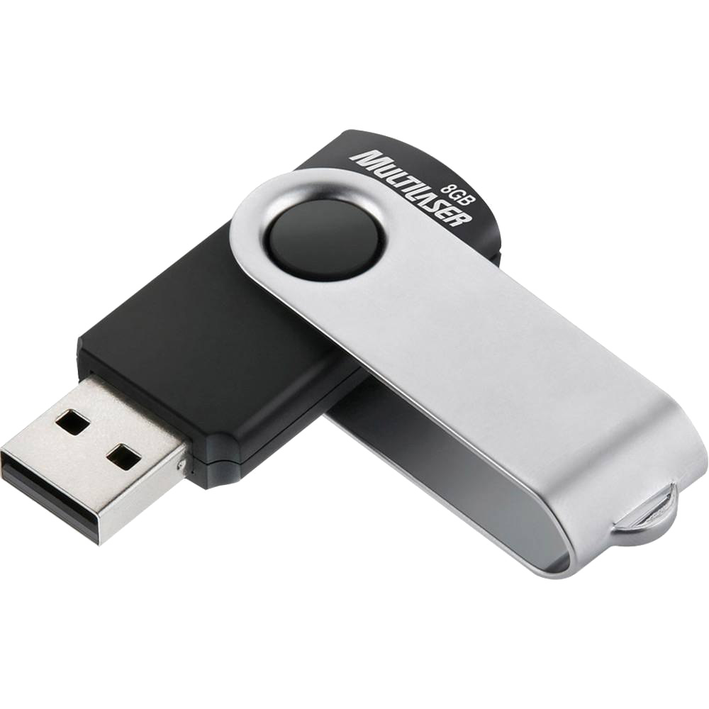
Step 1
                Insert the bootable pendrive

Slide 4
Step 2
Restart the device using function key using f10

Slide 5
Step 3
Create username and set a password

Slide 6
Step 4
Ubuntu installation is completed

